Slide 1

Research On Intellectual Property
Smith Dabreo 8382
Shaleel Rodrigues 8423

Slide 2

What Is Intellectual Property(IP)?
Intellectual Property is a property that arises from the human intellect. It is a product of human creation.
Intellectual Property comprises 2 distinct forms:
Literary & Artistic Works
Industrial Property

Slide 3
Literary & Artistic Works:
They are books, paintings, musical compositions, plays, movies, radio/tv programs, performances, & other artistic works.
Industrial Property:
Industrial Property describes physical matter that is the product of an idea or concept for commercial purposes.

Slide 4

Intellectual Property In Simple Words…
IP refers to something a person has thought of or created.
This ‘Property’ belongs to that person.
They have the right to decide:
Who is allowed to make it
How its used
Where its used
Who can sell and profit from it

Slide 5

How Do You Keep Your Intellectual Property Safe?
There are laws to protect your Intellectual Property(IP) whenever you decide to go public.
Four major paths to legal protections:
Patent
Copyright
Trademark
Trade Secrets

Slide 6

Who Protects IP?
WIPO ( World Intellectual Property Organization ) was established in 1967
The WIPO is a specialized agency of the United Nations.
It promotes the protection of IP throughout the world.
Its headquarters is in Geneva, Switzerland

Slide 7
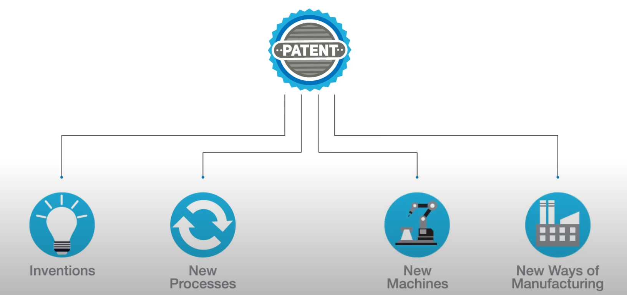
Patent:
A patent is the granting of a property right by a sovereign authority to an inventor. This grant provides the inventor exclusive rights to the patent for a designated period in exchange for a comprehensive disclosure of the invention
Things Covered By Patent:
Examples: The Light Bulb ( Patent Owned by Thomas Edison & Joseph Swan)
The Google PageRank ( Patent Owned by Larry Page)

Slide 8
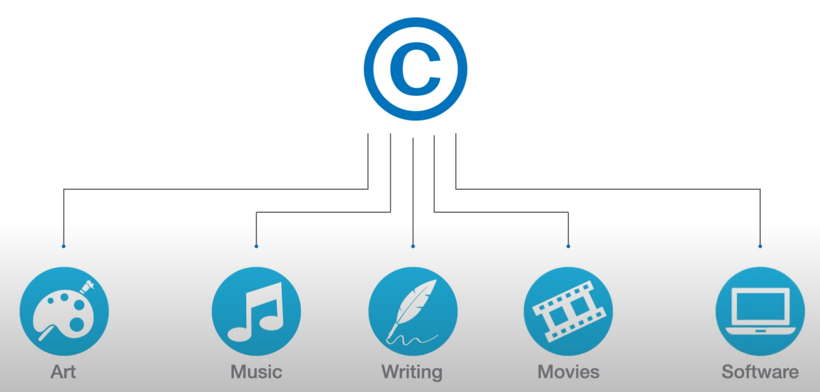
Copyright:
The exclusive and assignable legal right, given to the originator for a fixed number of years, to print, publish, perform, film, or record literary, artistic, or musical material.
Things Covered By Copyright:
Examples: Games produced by a company such as Epic Games
Music produced by music labels such as T-Series

Slide 9
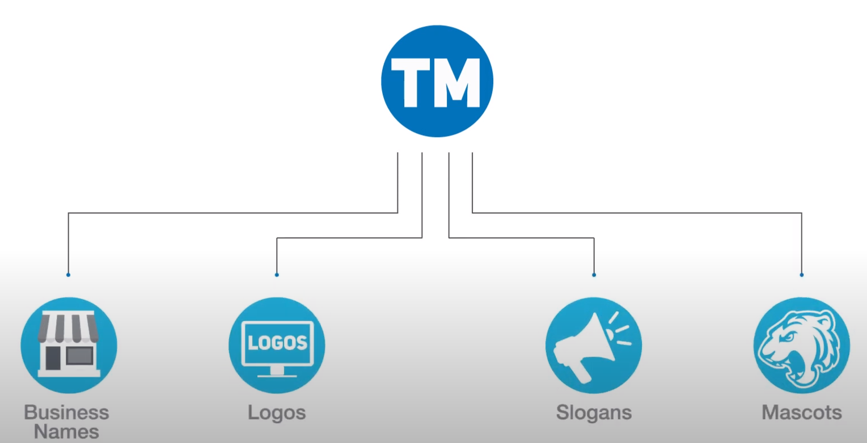
Trademarks:
A symbol, logo, word, sound, color, design, or other device that is used to identify a business or a product in commerce.
Things Covered By Trademark:
Examples: Microsoft
Nike

Slide 10
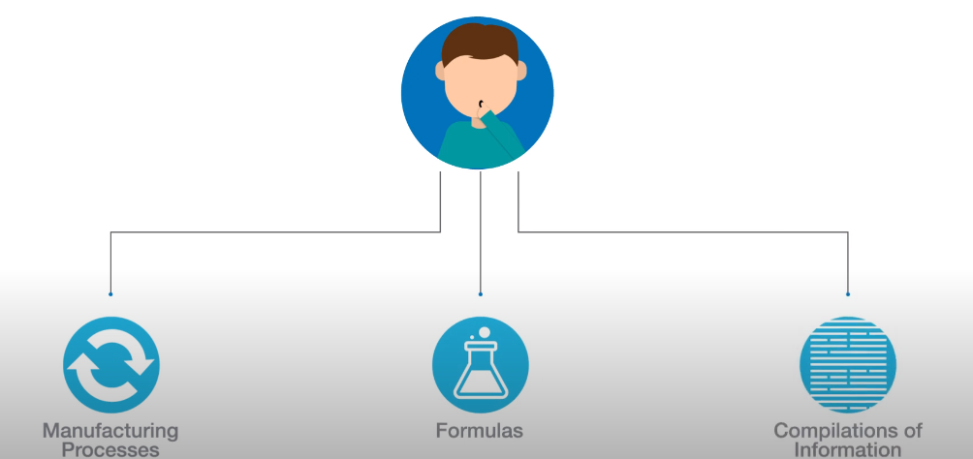
Trade Secrets:
Practice or process of a company that is generally not known outside of the company. This gives the company an economic advantage over its competitors and is often a product of internal research and development.
Things Covered By Trade Secrets:
Examples: The secret of Coca-Cola
The Google Search algorithm

Slide 11
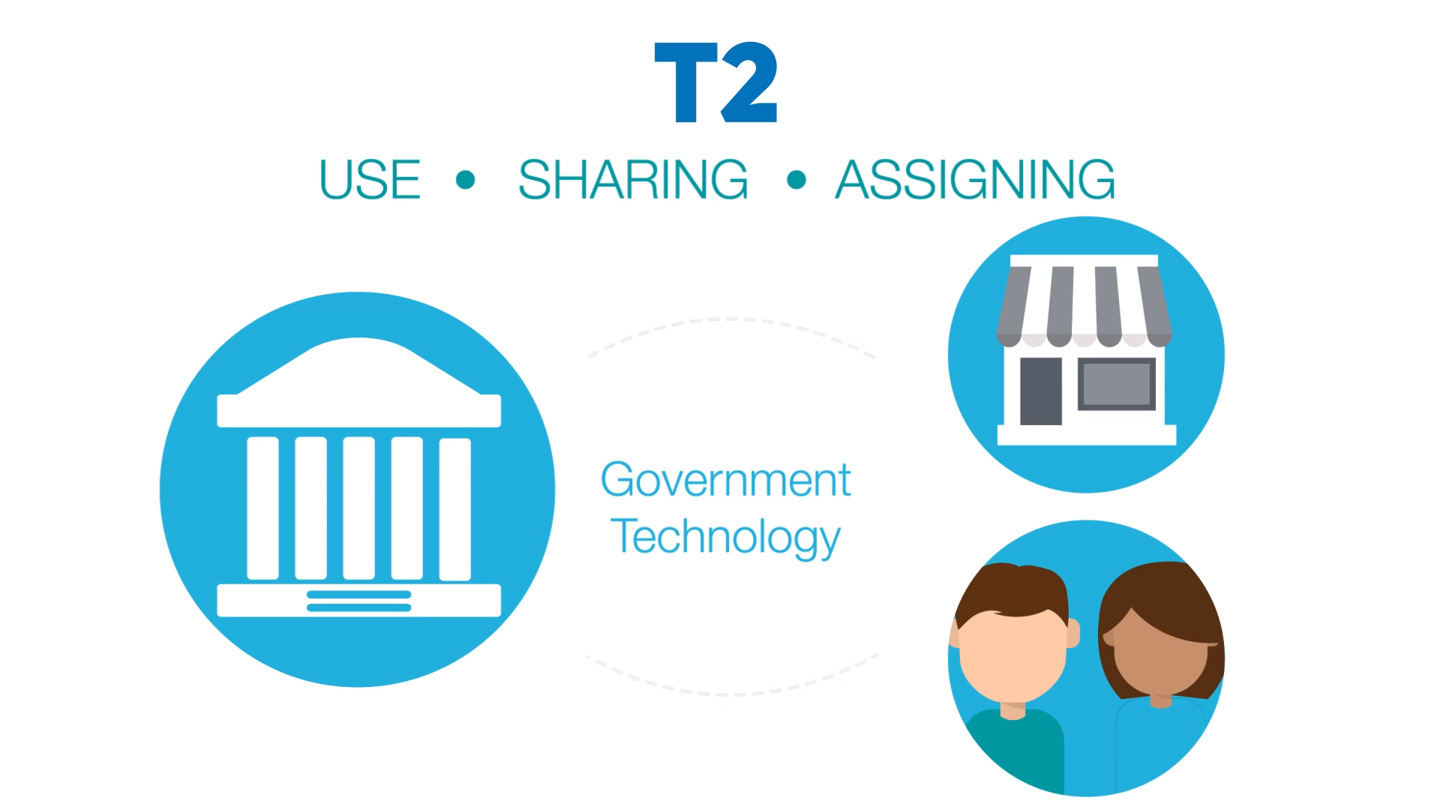
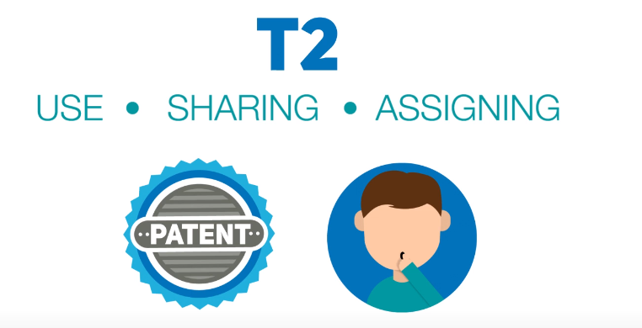
Getting this protections may seem tedious, Right?
- but its not.
Here’s where Technology Transfer or T2 comes in
T2 helps negotiate the use , sharing and assigning of IP so that companies and individuals can use government technology or a joined project between private sector and the government can take place.
T2 can make it easy to license a patent or share confidential information so both parties can help each other solve problems or create new products

Slide 12
Conclusion
Intellectual property (IP) is a category of property that includes intangible creations of the human intellect, and primarily encompasses copyrights, patents, and trademarks. It also includes other types of rights, such as publicity rights, moral rights, and rights against unfair competition.
The main purpose of intellectual property law is to encourage the creation of a large variety of intellectual goods. This gives economic incentive for their creation, because it allows people to profit from the information and intellectual goods they create. These economic incentives are expected to stimulate innovation and contribute to the technological progress of countries, which depends on the extent of protection granted to innovators.

Slide 13
Thank You!

